Slide 1
Heart Disease Detection
To determine the presence or absence of heart disease in patients
Notes:
Good afternoon everyone, I am Wang Jiayi and today I will be sharing my capstone project on the topic of Healthcare. The main objective of the project is regarding detection of heart disease, whether there is the presence or absence of it based on other measured attributes.

Slide 2
Overview
Introduction
Dataset used
Machine Learning procedure
Results discussion
Further considerations
Notes:
This will be the presentation outline for today. I will first give an introduction of the project and then discuss the dataset used, before going into the Machine Learning procedure and the results. Lastly, I will end off with my takeaway from this project and further considerations for improvement.

Slide 3

1. Introduction
“Cardiovascular diseases (CVDs) are the leading cause of death globally, taking an estimated 17.9 million lives each year.”
- (World Health Organization, n.d.)
Notes:
To give everyone an idea of why heart disease detection is crucial, here are some statistics taken from the World Health Organization. Cardiovascular diseases are the leading cause of death globally, taking an estimated 17.9 million lives each year. It is thus important to have an accurate detection on the likelihood of heart disease, given the patients’ other health measurements.

Slide 4
2. Dataset - Cleveland Heart Disease Dataset
303 rows of individuals’ data
14 columns in the dataset
Attribute characteristics:
Integer / Float
Presence of categorical variables
No missing data
The dataset is available from UCI Repository.
Notes:
The dataset that will be used in the project is the Cleveland Heart Disease Dataset. It consists of 303 rows of individuals’ data, over 14 columns in the given dataset. The actual dataset is actually much larger, with a total of 76 attributes. But after much investigation and testing by researchers, a final subset of 14 attributes is more commonly used. Hence, this project will be based on the 14 attributes identified. The characteristics of the attributes are mainly presented in an integer and float format, although there are categorical variables in an integer format as well. Based on initial checking, there is no missing data.

Slide 5
2. Dataset - Attributes
Age: age of the patient
Sex: sex of the patient – 2 values
Cp: chest pain type – 4 values
Trtbps: resting blood pressure
Chol: serum cholesterol
Fbs: fasting blood sugar– 2 values
Restecg: resting electrocardiographic results – 3 values
Thalacc – maximum heart rate achieved
Exng – exercise induced angina – 2 values
Oldpeak – ST depression induced by exercise relative to rest
Slp – slope of the peak exercise ST segment
Caa – number of major vessels colored by fluoroscopy – 4 values
Thall – a blood disorder called thalassemia – 3 values
Output (target): presence of heart disease – 2 values
*Categorical attributes marked in red
Notes:
Now I will briefly introduce these 14 attributes and their characteristics, before going more in-depth into these variables in the next section on Machine Learning procedure.

Slide 6
3. Machine Learning Procedure
Data pre-processing:
Visualization of data
Cleaning of data
Check for null values
Check for outliers
Encode categorical data
Normalization
Model selection:
Classification models
Hyper-parameter tuning
Present results!

Slide 7
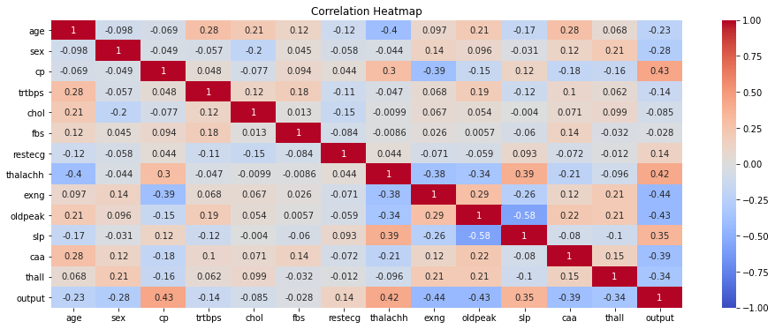
3. Machine Learning Procedure (1a)
cp, thalachh, exng, oldpeak, slp, caa, thall
seem to have a stronger correlation to the output

Slide 8
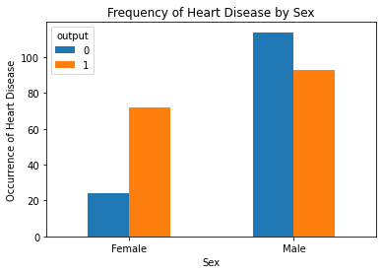
3. Machine Learning Procedure (1a)
Females seem to be more at risk of heart disease than males.
See also: Sex/Gender Differences in Cardiovascular Disease Prevention

Slide 9
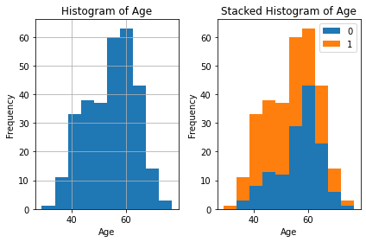
3. Machine Learning Procedure (1a)
Patients past the age of 40 have an increasingly higher risk of heart disease, based on the current sample population.

Slide 10
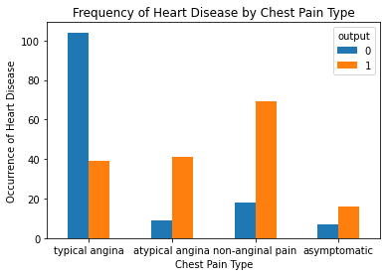
3. Machine Learning Procedure (1a)
The prevalence of heart disease is greater in
atypical angina, non-anginal pain, asymptomatic chest pain.

Slide 11
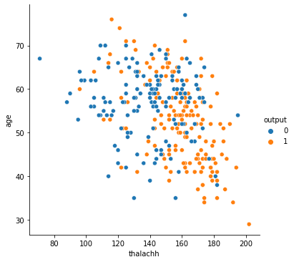
3. Machine Learning Procedure (1a)
There is a greater concentration of orange dots in the lower right quadrant, suggesting higher risk of heart disease in patients with higher maximum heart rate.

Slide 12
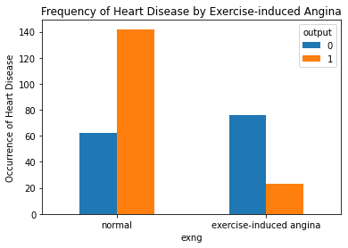
3. Machine Learning Procedure (1a)
Exercise-induced chest pain does not lead to higher chance of heart disease, as compared to other types of chest pain.

Slide 13
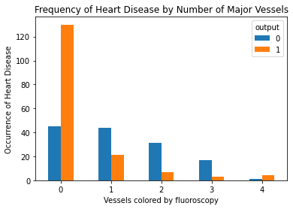
3. Machine Learning Procedure (1a)
Having more major vessels colored by fluoroscopy reduces the chance of heart disease.

Slide 14
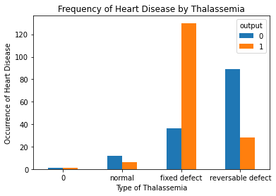
3. Machine Learning Procedure (1a)
Thalassemia of the fixed defect type is more likely to result in heart disease, whereas the normal and reversable defect type are not as likely to result in heart disease.

Slide 15




3. Machine Learning Procedure (1b)
Possible errors in the data
caa has 5 values instead of 4
thall has 4 values instead of 3
Solution: to replace erroneous values

Slide 16
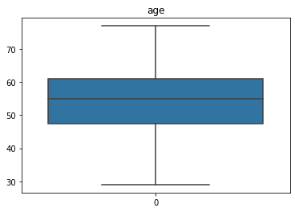
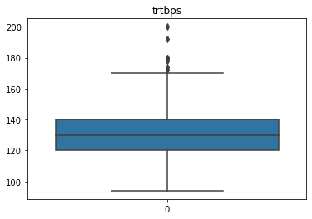
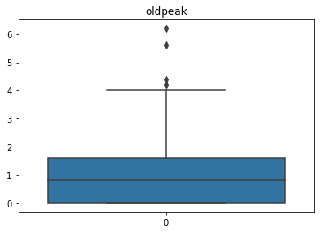
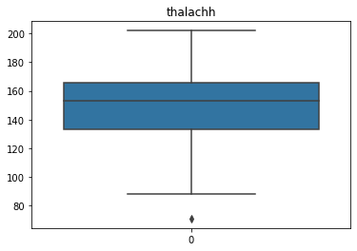
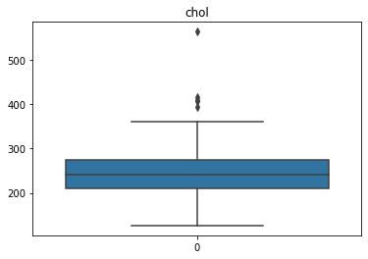
3. Machine Learning Procedure (1b)
However, outliers are not handled due to consideration of the realistic ranges of values.

Slide 17
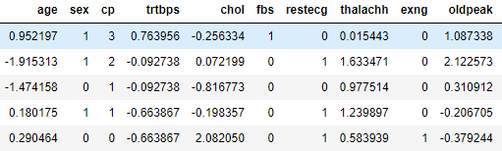
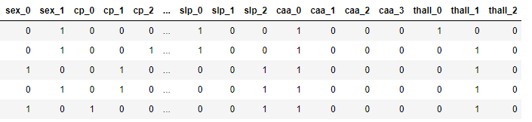
Scaling of continuous attributes
3. Machine Learning Procedure (1b)
Encoding of categorical attributes

Slide 18
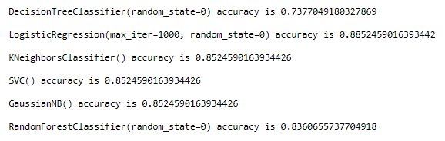
3. Machine Learning Procedure (2)
Model selection: Classification algorithms
Decision Tree
Logistic Regression
K-Nearest Neighbors
Support Vector Machine
Gaussian Naïve Bayes
Random Forest

Slide 19
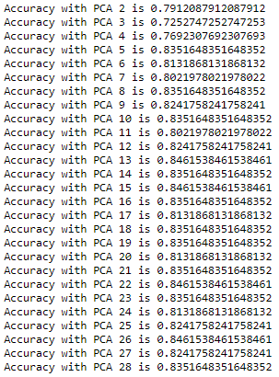
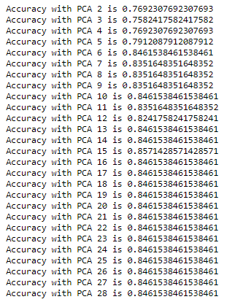
3. Machine Learning Procedure (3)
Principle Component Analysis
Using RFC Using LR

Slide 20
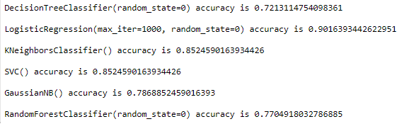

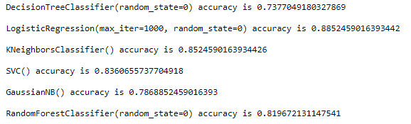
3. Machine Learning Procedure (3)
Principle Component Analysis
Using dimensions: 13
Using dimensions: 15

Slide 21

3. Machine Learning Procedure (3)
Cross-Validation
To ensure that the result we obtained is valid for other selections of the data
Although the accuracy has decreased slightly, it is still a good estimate.

Slide 22
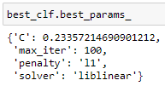

3. Machine Learning Procedure (3)
Grid-Search CV
To test what is the ideal model parameters for the dataset.
However, the accuracy score is not as high as the model using 13 components.

Slide 23
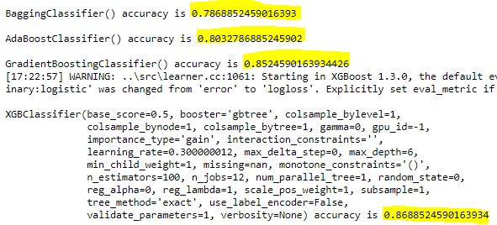
3. Machine Learning Procedure (3)
Others: Boosting
To test other models to see whether the accuracy can be improved.
However, the accuracy score is not as high as the model using 13 components.

Slide 24
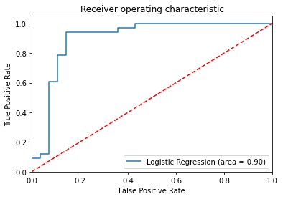
3. Machine Learning Procedure (4)
FINAL RESULTS:
Satisfactory ROC curve, close to the ideal, and with a large area underneath the graph.

Slide 25
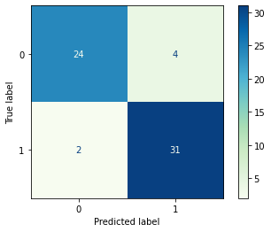
3. Machine Learning Procedure (4)
FINAL RESULTS:
The occurrence of False Negatives is low (2), suggesting that the model is a good predictor of the occurrence of heart disease.

Slide 26
4. Discussion of Results
Overall, the machine learning model showed high accuracy in the prediction of heart disease.
Logistic regression was the best performing model, with an average accuracy of 0.85 and higher.
Principle component analysis of 13 using logistic regression produced the highest accuracy of 0.90.
However, there were also many assumptions made and limitations during the procedure:
The erroneous values were replaced with the nearest occurring value.
Outliers were not handled, as the values were within the realistic ranges of the attributes.
The dataset is a fairly small one (~303 rows), and there are many attributes with only a few occurrences. However, the target variable is balanced so I decided to not include data augmentation.

Slide 27
5. Future Considerations
To better understand which attributes are more crucial in the prediction of heart disease (particularly for oldpeak)
Better graphing techniques to represent inter-variable effects, instead of only focusing on single attribute and target.
Inclusion of statistical analyses to test for the R^2 change with each attribute inclusion for a better PCA.
Practical implementations:
To create a simple program that allows users to input the values of each attribute and calculate the percentage likelihood of heart disease.
Need to account for missing values as well.

Slide 28

Thank you!
Project by: Wang Jiayi

